Slide 1

AVL Tree
Presented By
Anjuman ara
id:2024-1-60-279

Slide 2
TABLE of CONTENT
INTRODUCTION
CHARACTERISTICS of AVL TREE
APPLICATION of AVL TREE
PROS and CONS
CONCLUSION

Slide 3
Introduction
AVL Tree is also a Binary Search Tree but it is balanced tree.
Here balanced means the difference between height of right
subtree and left subtree must be -1 OR 0 OR +1.
In AVL Tree every node will have one extra information
known as BALANCE FACTOR.
BalanceFactor = HeightOfRightSubtree – HeightOfLeftSubtree
it can be proven that the height of an AVL tree with N nodes is O(log N)

Slide 4
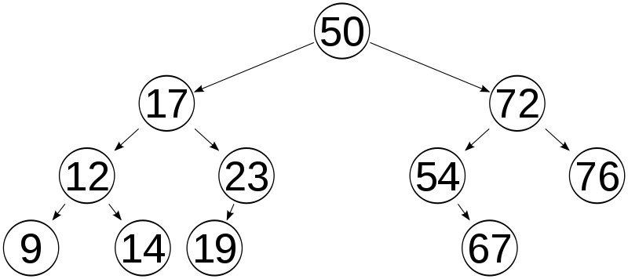
The AVL tree is named after its two Russian inventors, G.M. Adelson-Velskii and E.M. Landis, who published it in the 1962.
A-V & L proved that an AVL tree's height is always O(log N).
Example

Slide 5
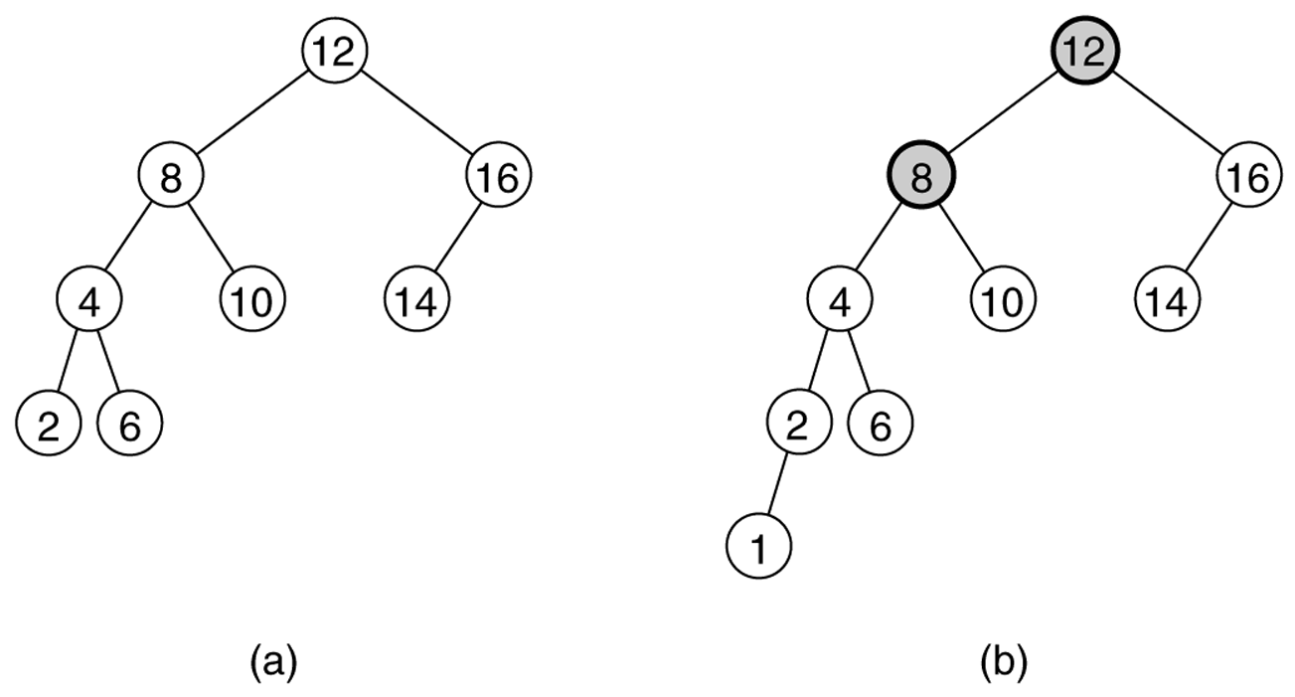
Two binary search trees:
(a) an AVL tree
(b) not an AVL tree (unbalanced nodes are darkened)

Slide 6
Which are valid AVL trees?
What is the balance factor of each tree node?
14
4
5
9
28
2
5
2
7
6
9
31
4
-1
8
4
20
44
3
-2
3
3
0
15
22
-4
1
11
33

Slide 7
Tracking subtree height
Many of the AVL tree operations depend on height.
Height can be computed recursively by walking the tree; too slow.
Instead, each node can keep track of its subtree height as a field:
private class TreeNode {
private E data;
private int height;
private TreeNode left;
private TreeNode right;
}
10
data
4
4
height
10
left/ right
3
2
5
20
1
2
1
1
2
9
15
30
1
7

Slide 8
After every insertion / deletion we need to check the BALANCE FACTOR
If it is other than -1 or 0 or +1 then we perform ROTATION to make the
Tree Balance.
Note
All AVL Trees are Binary Search Trees but All Binary Search Trees need not be AVL Tree
All Binary Search Trees are Binary Trees but All Binary Trees need not be Binary Search Tree

Slide 9
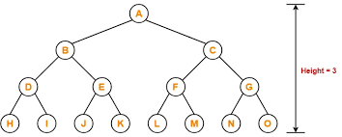
CHARACTERISTICS OF AVL TREE:
It follows the general properties of a Binary Search Tree.
Each subtree of the tree is balanced, i.e., the difference between the height of the left and right subtrees is at most 1.
The tree balances itself when a new node is inserted. Therefore, the insertion operation is time-consuming

Slide 10
Rotations
Left Rotation (LL)
Single
Rotation
Right Rotation (RR)
Left Right Rotation (LR)
Double
Rotation
Right Left Rotation (RL)

Slide 11
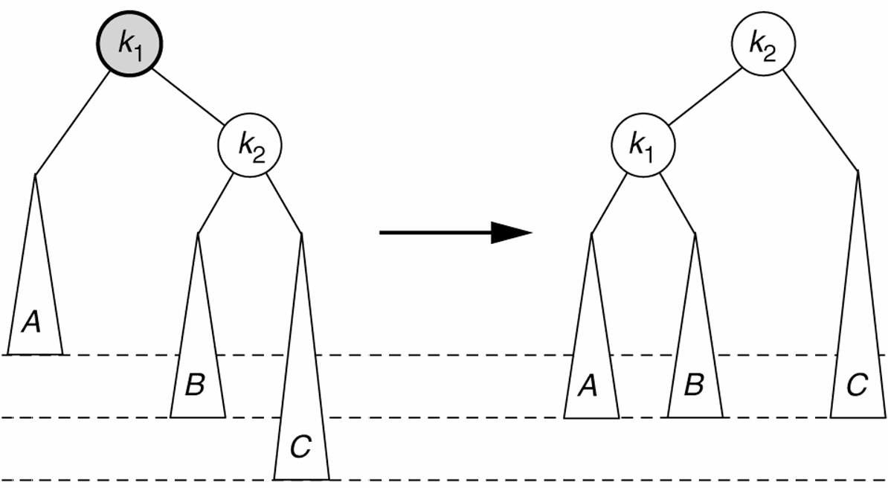
Left rotation
left rotation (counter-clockwise): (fixes Case 4 (RR))
right child k₂ becomes parent
original parent k₁ demoted to left
k₂'s original left subtree B (if any) is attached to k₁ as left subtree

Slide 12
LL Rotation
Insert: A , B , C
0
1
2
A
0
0
1
B
0
C

Slide 13
Left rotation code
private TreeNode leftRotate(TreeNode oldParent) {
// 1. detach right child's left subtree
TreeNode orphan = oldParent.right.left;
// 2. consider right child to be the new parent
TreeNode newParent = oldParent.right;
// 3. attach old parent onto left of new parent
newParent.left = oldParent;
// 4. attach new parent's old left subtree as
// right subtree of old parent
oldParent.right = orphan;
oldParent.height = height(oldParent); // update nodes'
newParent.height = height(newParent); // height values
return newParent;
}

Slide 14
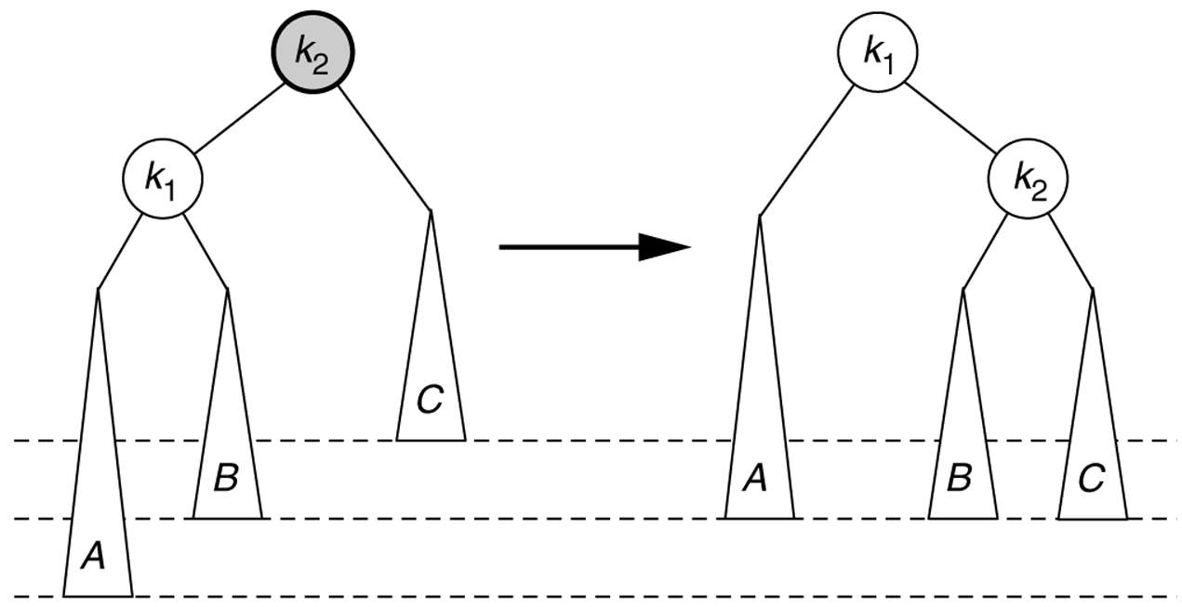
Right rotation
right rotation (clockwise): (fixes Case 1 (LL))
left child k₁ becomes parent
original parent k₂ demoted to right
k₁'s original right subtree B (if any) is attached to k₂ as left subtree

Slide 15
RR Rotation
Insert: C , B , A
0
1
2
C
0
0
1
B
0
A

Slide 16
Right rotation code
private TreeNode rightRotate(TreeNode oldParent) {
// 1. detach left child's right subtree
TreeNode orphan = oldParent.left.right;
// 2. consider left child to be the new parent
TreeNode newParent = oldParent.left;
// 3. attach old parent onto right of new parent
newParent.right = oldParent;
// 4. attach new parent's old right subtree as
// left subtree of old parent
oldParent.left = orphan;
oldParent.height = height(oldParent); // update nodes'
newParent.height = height(newParent); // height values
return newParent;
}

Slide 17
Right rotation code
private int height(TreeNode node) {
if (node == null) {
return 0;
}
int left = (node.left == null) ? 0 : node.left.height;
int right = (node.right == null) ? 0 : node.right.height;
return Math.max(left, right) + 1;
}

Slide 18
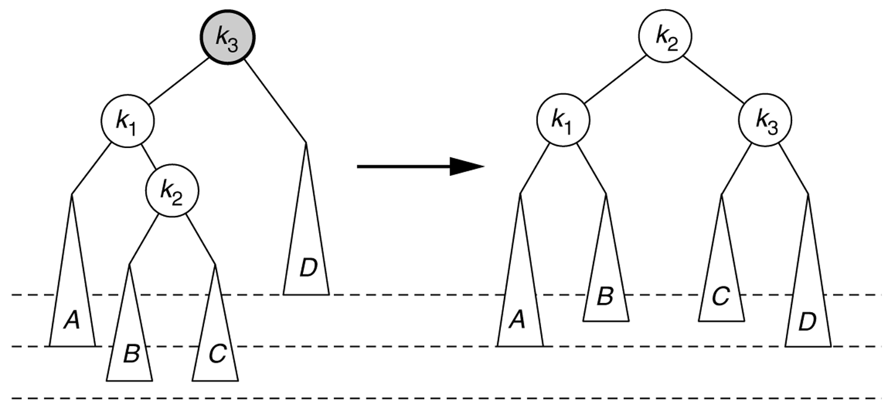
Left-right double rotation
left-right double rotation: (fixes Case 2 (LR))
1) left-rotate k₃'s left child ... reduces Case 2 into Case 1
2) right-rotate k₃ to fix Case 1

Slide 19
LR Rotation
Insert: C , A , B
0
1
2
C
0
0
1
A
0
B

Slide 20
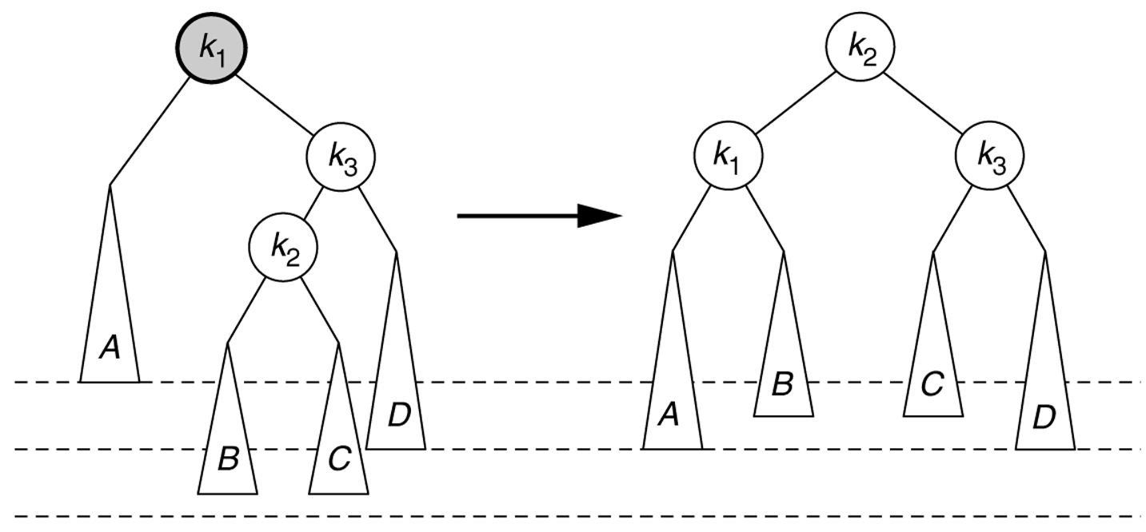
Right-left double rotation
right-left double rotation: (fixes Case 3 (RL))
1) right-rotate k₁'s right child ... reduces Case 3 into Case 4
2) left-rotate k₁ to fix Case 4

Slide 21
RL Rotation
Insert: A , C , B
0
1
2
A
0
1
0
C
0
B

Slide 22
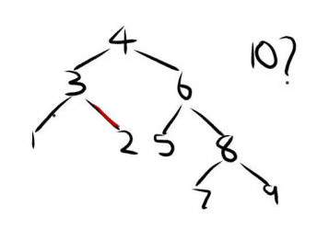
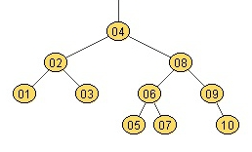
Example
Construct AVL Tree by inserting 1 to 10
1
2
3

Slide 23
Deletion
Deletion in AVL Tree have 3 cases
1. Deleting node without any child
2. Deleting node with one child
3. Deleting node with two children

Slide 24
1. Deleting node without any child
Step – 1:
Find given node in AVL Tree by performing search operation
Step – 2:
Remove given node in AVL Tree by using ‘delete’ operator
Step – 3:
Check balance factor of each node in AVL tree
Step – 4:
If tree is not balanced perform suitable Rotation operation to
make tree balanced

Slide 25
Deletion
Delete: 5
4
2
8
1
3
6
9
5
7
10

Slide 26
2. Deleting node with one child
Step – 1:
Find given node in AVL Tree by performing search operation
Step – 2:
Make a link between its Parent and its Child
Step – 3:
Remove given node in AVL Tree by using ‘delete’ operator
Step – 4:
Check balance factor of each node in AVL tree
Step – 5:
If tree is not balanced perform suitable Rotation operation to
make tree balanced

Slide 27
Deletion
Delete: 6
4
2
8
1
3
6
9
7
10

Slide 28
Deletion
Delete: 7
4
2
8
1
3
7
9
10

Slide 29
3. Deleting node with two children
Step – 1:
Find given node in AVL Tree by performing search operation
Step – 2:
Find the Smallest node in its Right Subtree
Step – 3:
Swap both given node and the Smallest node in its right subtree
Step – 4:
Remove given node in AVL Tree by using ‘delete’ operator
Step – 5:
Check balance factor of each node in AVL tree
Step – 6:
If tree is not balanced perform suitable Rotation operation to
make tree balanced

Slide 30
Deletion
Delete: 4
4
2
9
1
3
8
10

Slide 31
Thinking About AVL
Observations
+ Worst case height of an AVL tree is about 1.44 log n
+ Insert, Find, Delete in worst case O(log n)
+ Only one (single or double) rotation needed on insertion
+ Compatible with lazy deletion
- O(log n) rotations needed on deletion
- Height fields must be maintained (or 2-bit balance)
Coding complexity?

Slide 32
Alternatives to AVL Trees
Weight balanced trees
keep about the same number of nodes in each subtree
not nearly as nice
Splay trees
“blind” adjusting version of AVL trees
no height information maintained!
insert/find always rotates node to the root!
worst case time is O(n)
amortized time for all operations is O(log n)
mysterious, but often faster than AVL trees in practice (better low-order terms)

Slide 33
PROS and CONS
Arguments for AVL trees:
Search is O(log N) since AVL trees are always balanced.
Insertion and deletions are also O(logn)
The height balancing adds no more than a constant factor to the speed of insertion.
Arguments against using AVL trees:
Difficult to program & debug; more space for balance factor.
Asymptotically faster but rebalancing costs time.
Most large searches are done in database systems on disk and use other structures (e.g. B-trees).

Slide 34
CONCLUSION
AVL Trees are self-balancing binary search trees.
They ensure that the height difference (balance factor) between left and right subtrees never exceeds 1.
This guarantees O(log n) time complexity for search, insertion, and deletion operations.
Though rotations add overhead, they provide efficient performance in dynamic datasets.
Widely used where fast lookups and frequent updates are required.

Slide 35


